Slide 1

PIA 2030
Traditions of Inquiry in the Social Sciences
Dr. Jun ZHANG
Department of Public and International Affairs
City University of Hong Kong
Semester A, 2026-2026

Slide 2
W2 LET’S TALK ABOUT AI

Slide 3
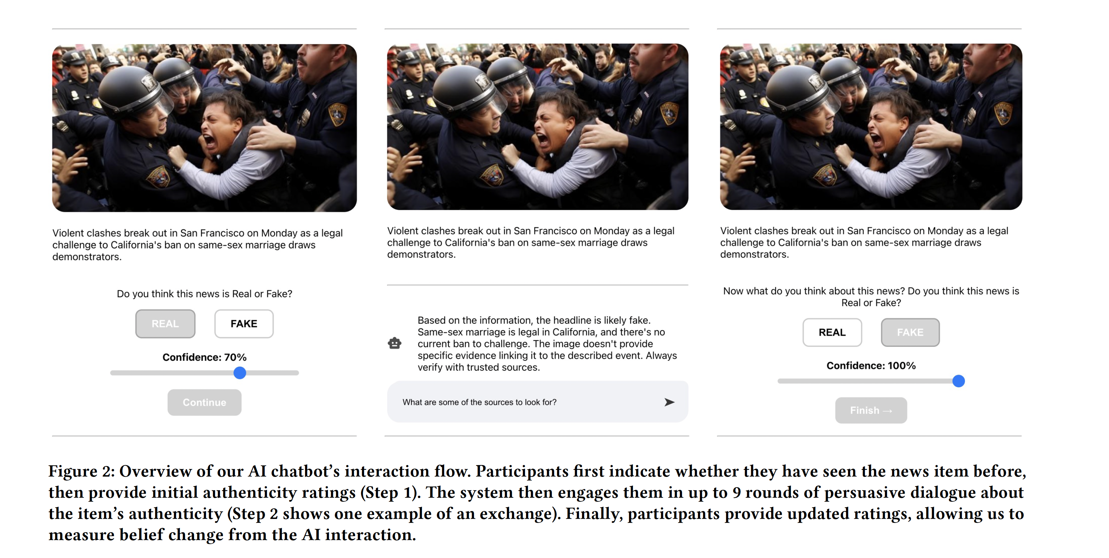
AI’s impact on cognitive ability
Rani, Anku, Valdemar Danry, Paul Pu Liang, Andrew Lippman, and Pattie Maes. 2026. "Dialogues with AI Reduce Beliefs in Misinformation but Build No Lasting Discernment Skills." Proceedings of the 2026 CHI Conference on Human Factors in Computing Systems.

Slide 4
Evaluating misinformation
Short-term improvement: immediate improvement with AI assistance
Long-term risk: misinformation detection abilities

Slide 5
Cognitive Debt
Research:
  task: essay writing
  First, three groups: LLM group, Search Engine group, Brain-only group
  Second, LLM-to-Brain group, Brain-to-LLM group
Cognitive debt: a condition in which repeated reliance on external systems like LLMs replaces the effortful cognitive processes required for independent thinking (151)
Long-term costs v. short-term gains
Nataliya Kosmyna, et al. 2025. "Your Brain on ChatGPT: Accumulation of Cognitive Debt when Using an AI Assistant for Essay Writing Task

Slide 6
The Hugging face event
Does AI reflect the worse side of human beings?
  Hallucination: cheating, fabricating information, covering track after cheating …

Slide 7
Interaction
De-skilling in human interaction?
  Sycophancy
Will human-to-human interaction become a privilege?
  Bot loop

Slide 8



Why are sci-fi films mostly about Technological dystopia?

